Slide 1
Credit Card Routing for Online Purchase via Predictive Modelling

Slide 2
Project Aim:
Help the business to automate the credit card routing via a predictive model. Such a model should increase the payment success rate by finding the best possible PSP for each transaction and at the same time keep the transaction fees low.

Slide 3
Used technologies: backend :python frontend:javascript,html Framework:Flask Deep Learning model: Tensorflow

Slide 4
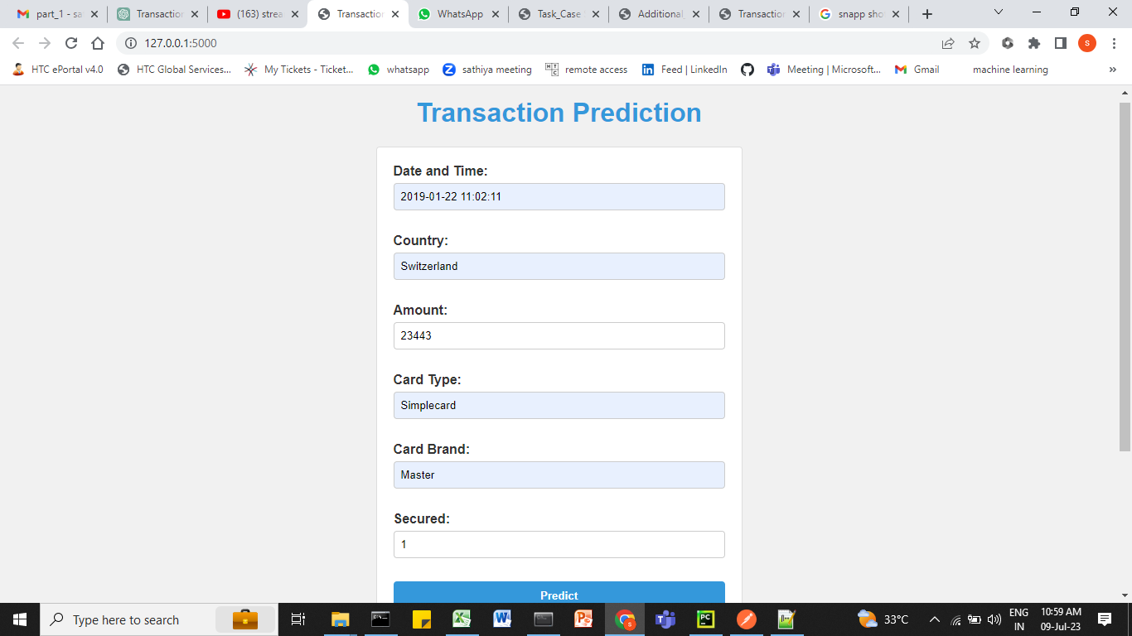
Result

Slide 5
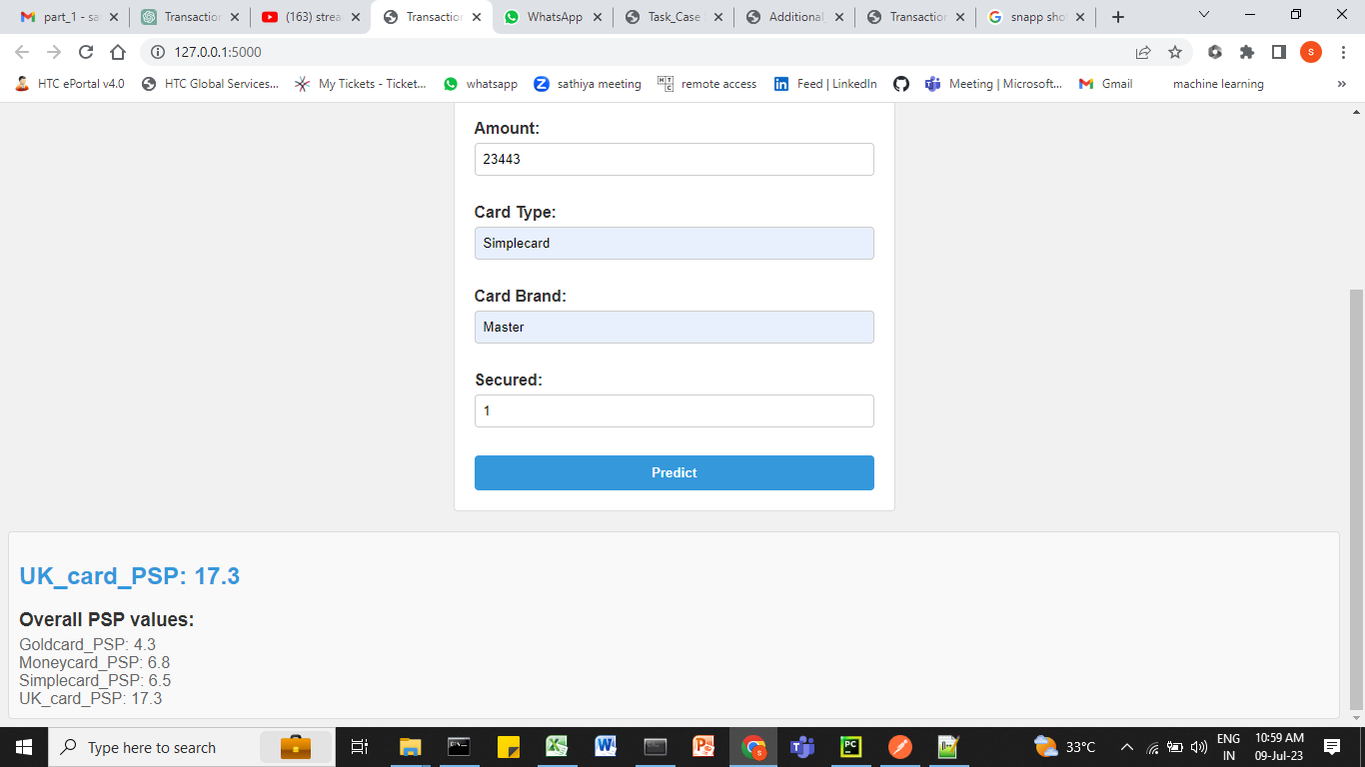

Slide 6
Result Based on the trained model:
UK_Card Payment service providers is better than all of them.

